Slide 1
AI-Driven Plagiarism Intelligence for Assignments
IBM HACKATHON PROJECT
Presented By:
NIMISHA SL
College Name & Department : K S INSTITUTE OF TECHNOLOGY,
Computer and Communication Engineering

Slide 2
OUTLINE
Problem Statement
Technology used
Wow factor
End users
Result
Conclusion
Git-hub Link
Future scope
IBM Certifications

Slide 3
Problem Statement
Academic institutions face growing challenges in detecting nuanced forms of plagiarism, especially those paraphrased or AI-generated. Traditional tools often: Lack contextual understanding,Ignore instructor-specific grading styles ,Cannot learn from past submissions or feedback..
Proposed Solution: Develop an AI-powered plagiarism detection agent using IBM Watsonx.ai and Granite foundation models. This system: Learns from historical submissions and instructor feedback. Identifies paraphrased or AI-generated content. Provides dynamic, context-sensitive plagiarism analysis.

Slide 4
Technology used
Natural Language Processing (NLP)
Retrieval-Augmented Generation (RAG)
Vector Embeddings
Prompt Engineering
Semantic Similarity Detection
AI Content Classification Cloud Functions or App Runtime

Slide 5
IBM cloud services used
IBM Watsonx.ai Studio
IBM Granite Foundation Models
IBM Cloud Object Storage
IBM Watson Machine Learning
IBM Cloud Functions
IBM Cloud Agent Lab

Slide 6
Wow factors
Learns and adapts to instructor-specific grading and writing patterns to increase detection accuracy
Detects paraphrased content even when reworded with advanced language or AI tools
Identifies and flags AI-generated content using contextual prompt evaluation
Generates similarity scores along with clear explanations for each flagged section
Suggests alternative phrasing to help students rewrite potentially plagiarized content
Can be integrated with Learning Management Systems (LMS) like Moodle or Canvas for seamless assignment checks

Slide 7
End users
University Professors – to evaluate assignment originality
Academic Institutions – to maintain academic integrity
Students – to verify and improve originality before submission
Examination Boards / Admins – for auditing and review

Slide 8
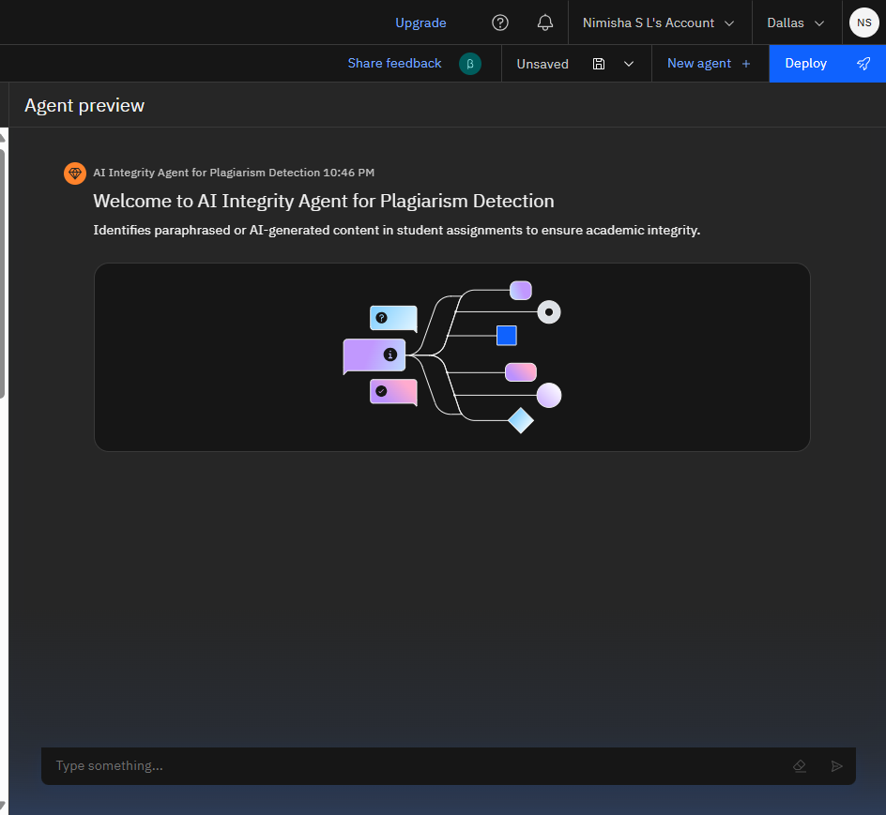
Results
AI Integrity Agent for Plagiarism Detection successfully configured using the granite-3-3-8b-instruct model.
It is ready to identify paraphrased or AI-generated content in student submissions to uphold academic integrity.

Slide 9
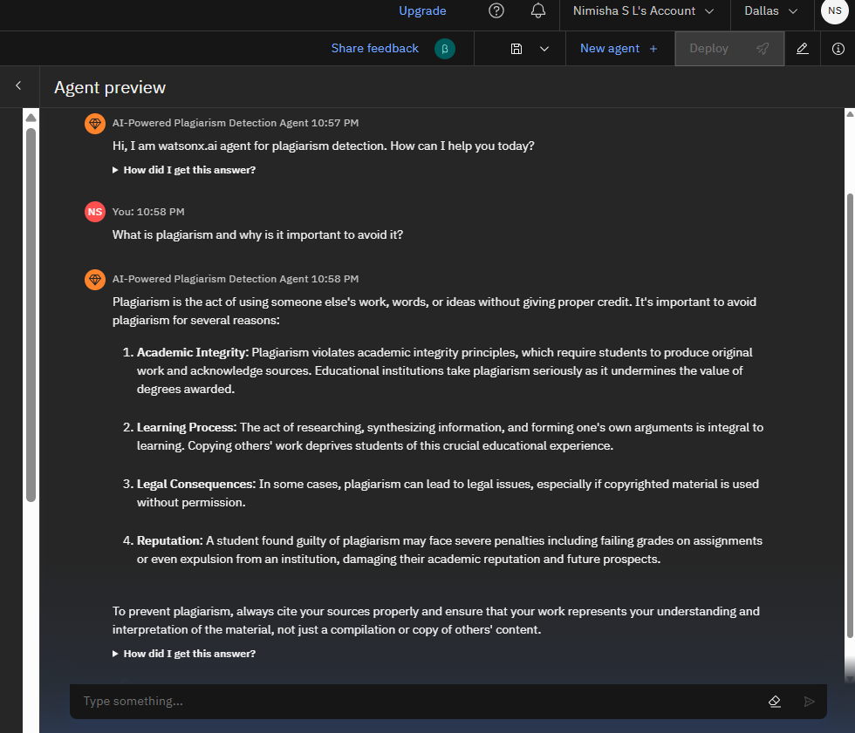
Results

Slide 10
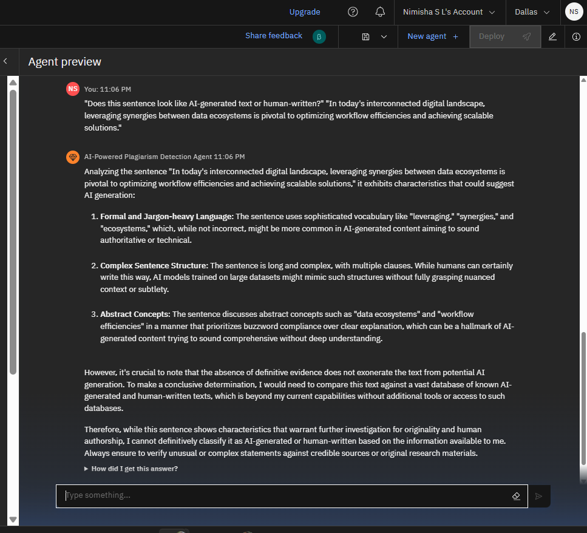
Results

Slide 11
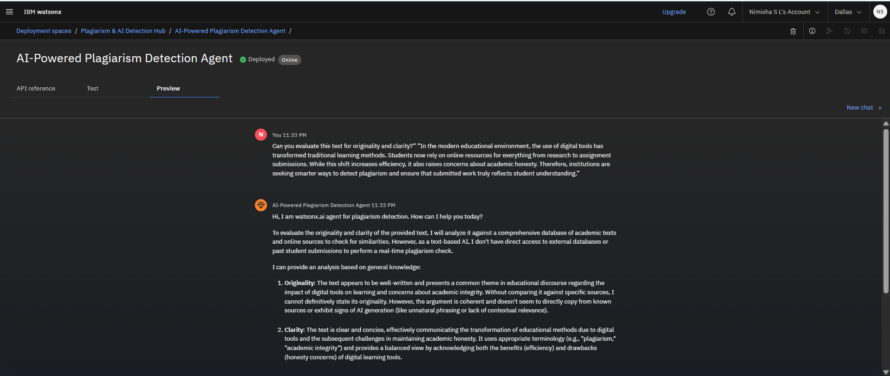
Results
Deployed AI Agent

Slide 12
Conclusion
The AI agent helps automate plagiarism detection with contextual sensitivity.
Enhances fairness and academic quality.
Saves instructor time, reduces false positives, and discourages misuse of AI tools.
Supports originality improvement through rewrite suggestions.

Slide 13
GitHub Link
https://github.com/nimishaaaaa27/AI-Driven-Plagiarism-Intelligence-for-Assignments

Slide 14
Future scope
Multilingual content support
Real-time voice-based assignment checks
Cross-institutional plagiarism network
LMS and Turnitin plugin integration
Mobile/web student originality checker
Research paper similarity analysis

Slide 15
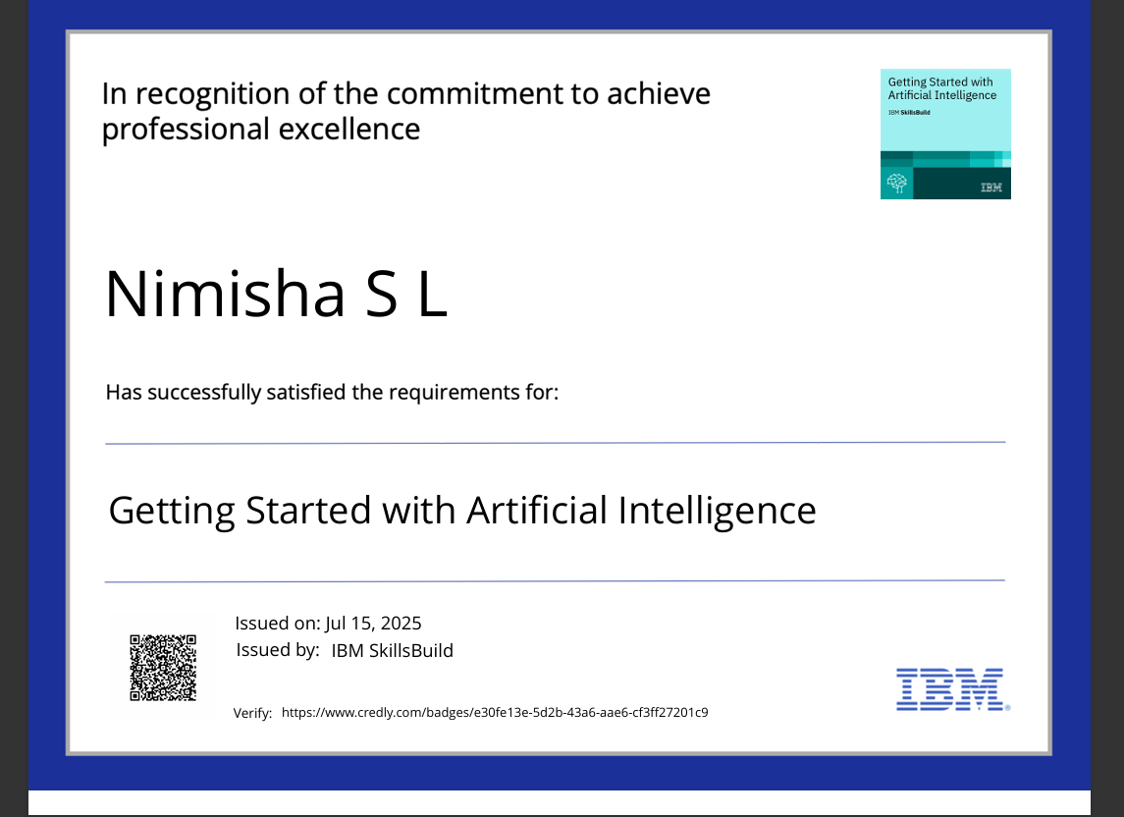
IBM Certifications
Screenshot/ credly certificate( getting started with AI)

Slide 16
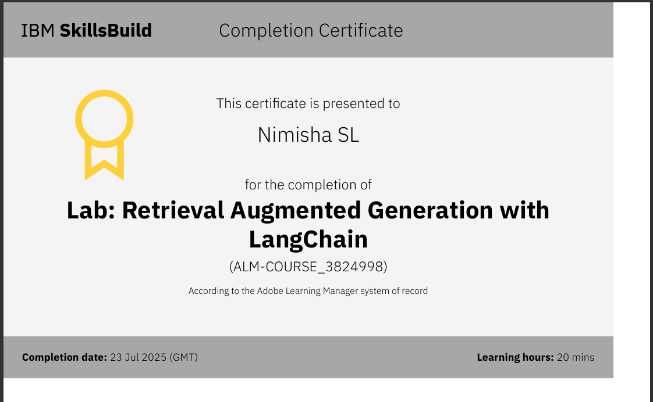

Slide 17
THANK YOU

